Slide 1
Introduction
Management of main memory is critical
Entire system performance dependent on two items
  How much memory is available
  Optimization of memory during job processing
This chapter introduces:
  Memory manager
  Four types of memory allocation schemes
    Single-user systems
    Fixed partitions
    Dynamic partitions
    Relocatable dynamic partitions

Slide 2
Single-User Contiguous Scheme
Commercially available in 1940s and 1950s
Entire program loaded into memory
Contiguous memory space allocated as needed
Jobs processed sequentially
Memory manager performs minimal work
  Register to store the base address
  Accumulator to track program size

Slide 3
Single-User Contiguous Scheme (cont'd.)
Disadvantages
  No support for multiprogramming or networking
  Not cost effective
  Program size must be less than memory size to execute

Slide 4
Fixed Partitions
Commercially available in 1950s and 1960s
Main memory is partitioned
  At system startup
  One contiguous partition per job
Permits multiprogramming
Partition sizes remain static
  Must shut down computer system to reconfigure
Requires:
  Protection of the job’s memory space
  Matching job size with partition size

Slide 5
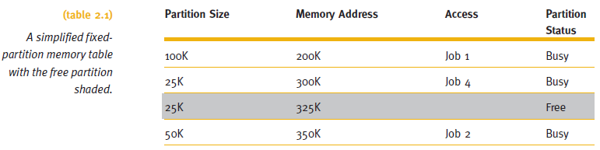
Fixed Partitions (cont'd.)
Memory manager allocates memory space to jobs
  Uses a table

Slide 6
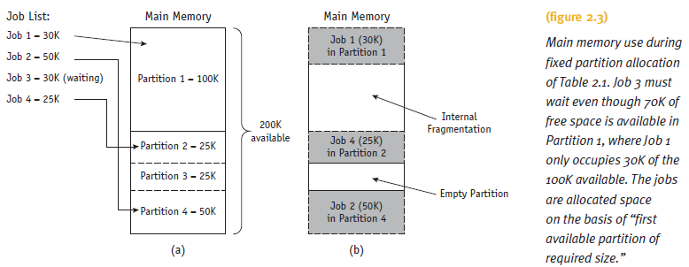
Fixed Partitions (cont'd.)

Slide 7
Fixed Partitions (cont'd.)
Disadvantages
  Requires contiguous loading of entire program
  Job allocation method
    First available partition with required size
  To work well:
    All jobs must be same size and memory size known ahead of time
  Arbitrary partition size leads to undesired results
    Partition too small
      Large jobs have longer turnaround time
    Partition too large
      Memory waste: internal fragmentation

Slide 8
Dynamic Partitions
Main memory is partitioned
  Jobs given memory requested when loaded
  One contiguous partition per job
Job allocation method
  First come, first serve allocation method
  Memory waste: comparatively small
Disadvantages
  Full memory utilization only during loading of first jobs
  Subsequent allocation: memory waste
    External fragmentation: fragments between blocks

Slide 9
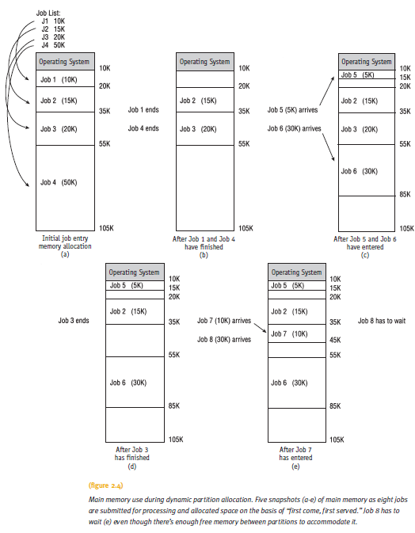
Dynamic Partitions (cont'd.)

Slide 10
Best-Fit Versus First-Fit Allocation
Two methods for free space allocation
  First-fit memory allocation: first partition fitting the requirements
    Leads to fast allocation of memory space
  Best-fit memory allocation: smallest partition fitting the requirements
    Results in least wasted space
    Internal fragmentation reduced, but not eliminated
Fixed and dynamic memory allocation schemes use both methods

Slide 11
Best-Fit Versus First-Fit Allocation (cont'd.)
First-fit memory allocation
  Advantage: faster in making allocation
  Disadvantage: leads to memory waste
Best-fit memory allocation
  Advantage: makes the best use of memory space
  Disadvantage: slower in making allocation

Slide 12
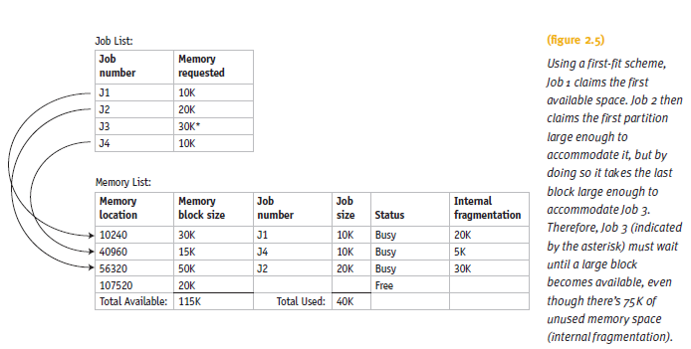
Best-Fit Versus First-Fit Allocation (cont'd.)

Slide 13
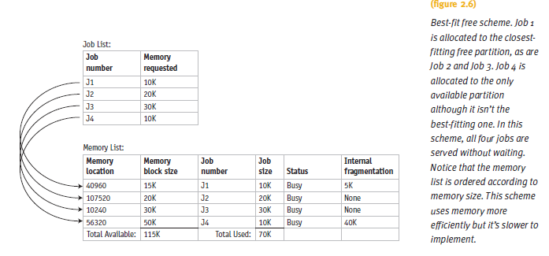
Best-Fit Versus First-Fit Allocation (cont'd.)

Slide 14
Best-Fit Versus First-Fit Allocation (cont'd.)
Algorithm for first-fit
  Assumes memory manager keeps two lists
    One for free memory
    One for busy memory blocks
  Loop compares the size of each job to the size of each memory block
    Until a block is found that is large enough to fit the job
  Job stored into that block of memory
  Memory Manager moves out of the loop
    Fetches next job from the entry queue

Slide 15
Best-Fit Versus First-Fit Allocation (cont'd.)
Algorithm for first-fit (cont'd.):
  If entire list searched in vain
    Then job is placed into waiting queue
    Otherwise, Memory Manager fetches next job
  Process repeats

Slide 16
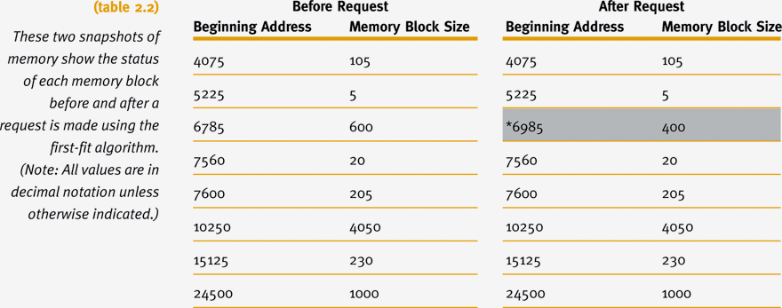
Best-Fit Versus First-Fit Allocation (cont'd.)

Slide 17
Best-Fit Versus First-Fit Allocation (cont'd.)
Algorithm for best-fit
  Goal
    Find the smallest memory block into which the job will fit
  Entire table searched before allocation

Slide 18
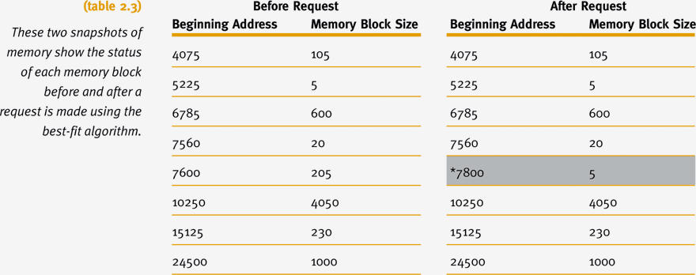
Best-Fit Versus First-Fit Allocation (cont'd.)

Slide 19
Best-Fit Versus First-Fit Allocation (cont'd.)
Hypothetical allocation schemes
  Next-fit: starts searching from last allocated block, for next available block when a new job arrives
  Worst-fit: allocates largest free available block to new job
    Opposite of best-fit
    Good way to explore theory of memory allocation
    Not best choice for an actual system

Slide 20
Deallocation
Deallocation: freeing allocated memory space
For fixed-partition system:
  Straightforward process
  Memory Manager resets the status of job’s memory block to “free” upon job completion
  Any code may be used
  Example code: binary values with zero indicating free and one indicating busy

Slide 21
Deallocation (cont'd.)
For dynamic-partition system:
  Algorithm tries to combine free areas of memory
  More complex
Three dynamic partition system cases
  Case 1: When the block to be deallocated is adjacent to another free block
  Case 2: When the block to be deallocated is between two free blocks
  Case 3: When the block to be deallocated is isolated from other free blocks

Slide 22
Case 1: Joining Two Free Blocks
Blocks are adjacent
List changes to reflect starting address of the new free block
  Example: 7600 - the address of the first instruction of the job that just released this block
Memory block size changes to show its new size for the new free space
  Combined total of the two free partitions
  Example: (200 + 5)

Slide 23
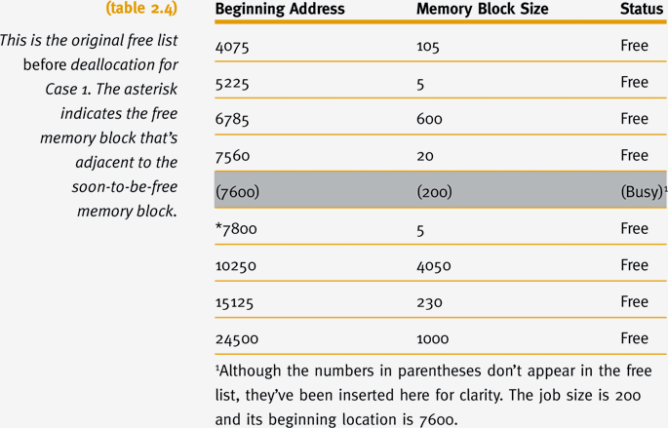
Case 1: Joining Two Free Blocks (cont'd.)

Slide 24
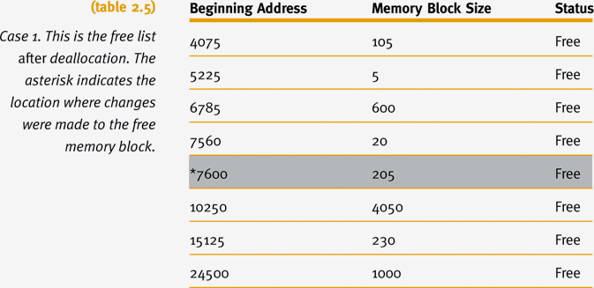
Case 1: Joining Two Free Blocks (cont'd.)

Slide 25
Case 2: Joining Three Free Blocks
Deallocated memory space
  Between two free memory blocks
List changes to reflect starting address of new free block
  Example: 7560 was smallest beginning address
Sizes of the three free partitions must be combined
  Example: (20 + 20 + 205)
Combined entry (last of the three) given status of “null”
  Example: 7600

Slide 26
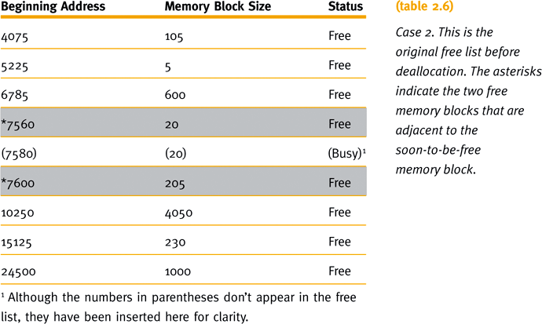
Case 2: Joining Three Free Blocks (cont'd.)

Slide 27
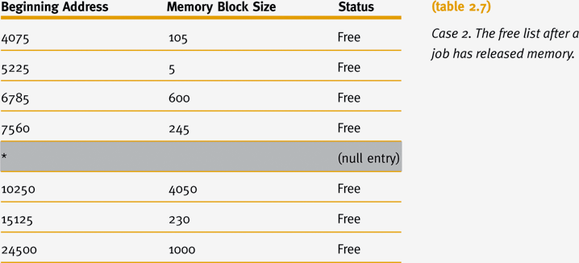
Case 2: Joining Three Free Blocks (cont'd.)

Slide 28
Case 3: Deallocating an Isolated Block
Deallocated memory space
  Isolated from other free areas
System determines released memory block status
  Not adjacent to any free blocks of memory
  Between two other busy areas
System searches table for a null entry
  Occurs when memory block between two other busy memory blocks is returned to the free list

Slide 29
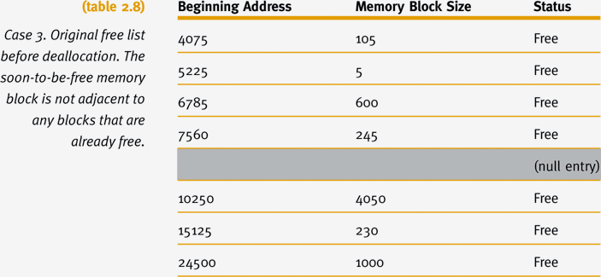
Case 3: Deallocating an Isolated Block (cont'd.)

Slide 30
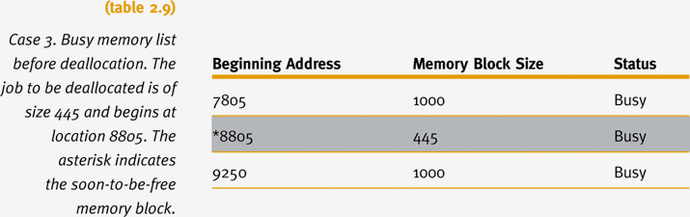
Case 3: Deallocating an Isolated Block (cont'd.)

Slide 31
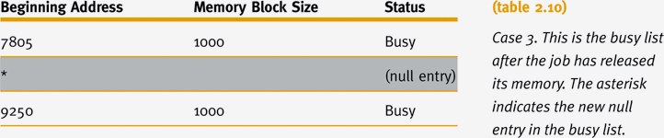
Case 3: Deallocating an Isolated Block (cont'd.)

Slide 32
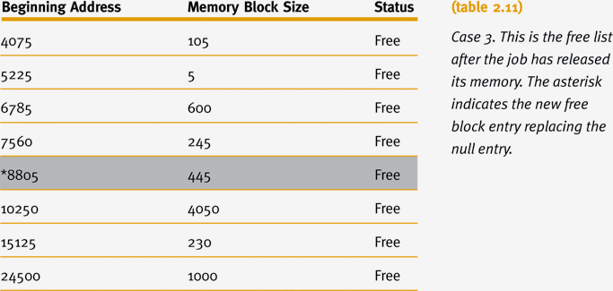
Case 3: Deallocating an Isolated Block (cont'd.)

Slide 33
Relocatable Dynamic Partitions
Memory Manager relocates programs
  Gathers together all empty blocks
Compact the empty blocks
  Make one block of memory large enough to accommodate some or all of the jobs waiting to get in

Slide 34
Relocatable Dynamic Partitions
(cont'd.)
Compaction: reclaiming fragmented sections of memory space
  Every program in memory must be relocated
    Programs become contiguous
  Operating system must distinguish between addresses and data values
    Every address adjusted to account for the program’s new location in memory
    Data values left alone

Slide 35
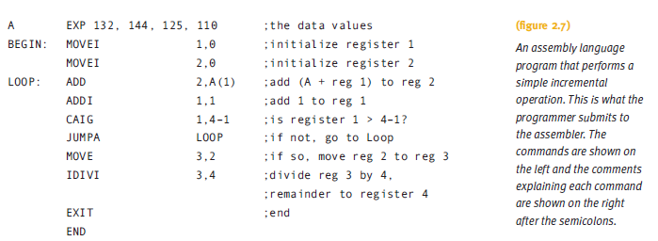
Relocatable Dynamic Partitions
(cont'd.)

Slide 36
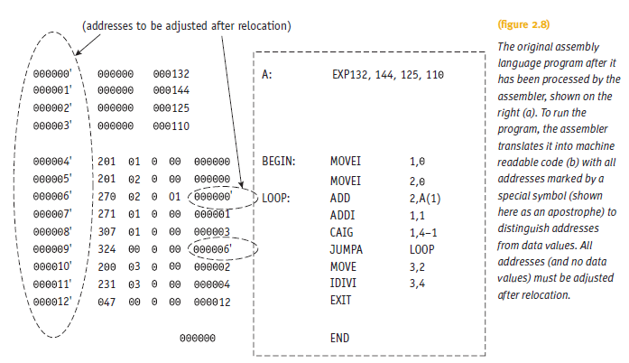
Relocatable Dynamic Partitions
(cont'd.)

Slide 37
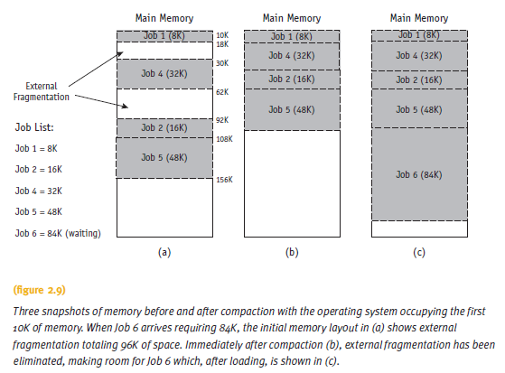
Relocatable Dynamic Partitions
(cont'd.)

Slide 38
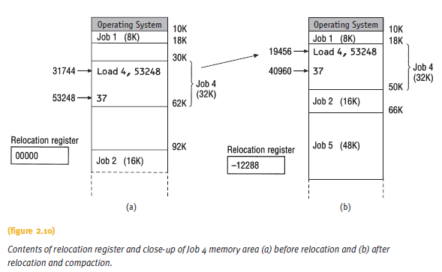
Relocatable Dynamic Partitions
(cont'd.)

Slide 39
Relocatable Dynamic Partitions
(cont'd.)
Compaction issues:
  What goes on behind the scenes when relocation and compaction take place?
  What keeps track of how far each job has moved from its original storage area?
  What lists have to be updated?
Understanding Operating Systems, Sixth Edition

Slide 40
Relocatable Dynamic Partitions
(cont'd.)
What lists have to be updated?
  Free list
    Must show the partition for the new block of free memory
  Busy list
    Must show the new locations for all of the jobs already in process that were relocated
  Each job will have a new address
    Exception: those already at the lowest memory locations

Slide 41
Relocatable Dynamic Partitions
(cont'd.)
Special-purpose registers used for relocation:
  Bounds register
    Stores highest location accessible by each program
  Relocation register
    Contains the value that must be added to each address referenced in the program
    Must be able to access the correct memory addresses after relocation
    If the program is not relocated, “zero” value stored in the program’s relocation register

Slide 42
Relocatable Dynamic Partitions
(cont'd.)
Compacting and relocating optimizes use of memory
  Improves throughput
Options for timing of compaction:
  When a certain percentage of memory is busy
  When there are jobs waiting to get in
  After a prescribed amount of time has elapsed
Compaction entails more overhead
Goal: optimize processing time and memory use while keeping overhead as low as possible

Slide 43
Summary
Four memory management techniques
  Single-user systems, fixed partitions, dynamic partitions, and relocatable dynamic partitions
Common requirements of four memory management techniques
  Entire program loaded into memory
  Contiguous storage
  Memory residency until job completed
Each places severe restrictions on job size
Sufficient for first three generations of computers

